Slide 1

SEN 101
Introduction to Computing and Application
Ibrahim Abdullahi
Nile University of Nigeria, Abuja
Faculty of Natural and Applied Science Department of Software Engineering
© Adopted from Umar Adam Ibrahim

Slide 2
Content
Goal of the course
Course Administration
Introduction and Overview
2

Slide 3
Goal
Expand what you already know about computer
Comprehensive introduction to future courses in the field
Foundation of relevance and interrelationship of the future courses
Investigate wide range of topic
Status of research
Establish a functional understanding of CS
Support those who wish to pursue more specialized studies
3

Slide 4
Course Administrative
Course Meeting Times
Lectures: 1 session/ week, 2hrs/ session & labs inbetween
Lectures
Lecture material (oral comments)
Additional reading
Recitations
Opportunity to ask questions (interact with staff vs classmate)
Attendance is mandatory
Participation counts for a part of your grade
4

Slide 5
Con’t….
Assignment/Project
Submission must be uploaded to the online classroom.
Late homework will generally not be accepted. (Prior arrangements for extenuating circumstances)
They should be uploaded in PDF form by 11:59PM of the due date
Exams
There will be one quiz
One midterm and final exams will be given.
5

Slide 6
Con’t….
Grading Policy
Final grade
Quiz will be 10 points
Midterm exams will be 20 points
Assignments 10 points
A final exams 60 points
No make-up for (quiz, assignment/project)
6

Slide 7
Contact detail vs Listing online
Office
Block C - Room 111
Office hour
On appointment
Email
Ibrahim.abdullahi@nileuniversity.edu.ng
Online teams class room code; c47vg6j
7

Slide 8
Course Syllabus
Week | Dates | Topics
1 |  | Introduction and Overview
2 |  | Data Storage - Data Manipulation
3 |  | Operating Systems - Networking
4 |  | LAB 1
5 |  | Internet
6 |  | Algorithms
7 |  | LAB 2 - Quiz 1
8 |  | Midterm Exam
9 |  | Programming Languages
10 |  | Software Engineering
11 |  | Data Structure
12 |  | Database Systems
13 |  | LAB 3 - Quiz 2
14 |  | Revision week
15 |  | Final Exam

Slide 9

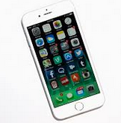


Computer vs computer science
Computers are everywhere
Data storage and manipulation
So far almost all of you have used a computer
Desktop
Laptop
Smartphone
Car
9

Slide 10

Computer vs computer science
Computer science
Computer design
Algorithms; solution
for a problem
Information processing
Computer programming
Software engineering
Data Science
Hardware design
Machine Learning
Internet of Things, Artificial Intelligence (Robotics)
Areas of Computing
Underpinning for today’s computer application.
Foundations for tomorrow’s applications.
10
Notes:
Artificial intelligence (AI) refers to the simulation of human intelligence in machines that are programmed to think like humans and mimic their actions. The term may also be applied to any machine that exhibits traits associated with a human mind such as learning and problem-solving

Slide 11

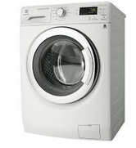
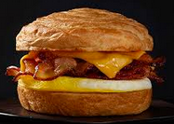
The Role of Algorithms
Algorithms is a set of steps that defines how a task is performed.
More precise later in lecture 5
Examples
11

Slide 12

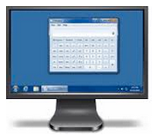
The Role of Algorithms
Before a computer perform a task
Discover and represent algorithms compatible with machine
A machine-like representation of algorithms is called a program
Conveniences for humans = computer programs
computer programs are encoded in a manner that is
compatible with the technology of the machine.
Program + encode + load to a machine = programming
Program + algorithms = software, run by hardware
12

Slide 13




Algorithms
Algorithms
Subject in mathematics
Algorithms
Before
Mathematicians
Examples of early research
Long division algorithms
Euclidean algorithms discovered by ancient Greek mathematician Euclid
13

Slide 14
Long Division Algorithm
D = Divide M = Multiply S = Subtract B = Bring down
Procedure:
start
Step 1: D for Divide
Step 2: M for Multiply
Step 3: S for Subtract
Step 4: B for Bring down
Start all over again unless division completed.
end
14

Slide 15
Machine capability
Exist
Algorithm
No
Define algorithm
Yes
Construct machine
15

Slide 16
Computer science redefined
What is computer science?
CS is often difficult to define.
Beyond the study of computer but computer is vital in the discipline as tool.
CS is a study of problem, problem-solving and the solution that come out a problem solving process. The goal of CS is to provide algorithms.
CS can be thought of as a study of algorithm. But also include some problem may not have a solution.
A study of solution to problems as well as the study of problems with no solutions.
16

Slide 17


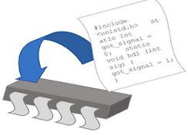




Computer science redefined
Computer science is a science of algorithms
Intelligence
science
Algorithm
Mathematics
Engineering
Psychology
Biology
Business admin.
17

Slide 18
Key question for a computer science
Which problems can be solved by algorithmic processes?
How can discovery of algorithms be made easier?
How can techniques of representing and communicating algorithms be improved?
How can our knowledge of algorithms and technology be applied to provide better machines?
How can characteristics of different algorithms be analyzed and compared?
18

Slide 19
An Outline of Our Study
Data storage.
Data manipulation.
Operating system.
Networking and the Internet.
Algorithms.
Programming languages.
Software engineering.
Data structure.
Database systems.
19

Slide 20
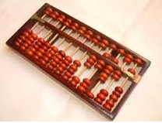
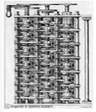
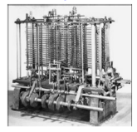
Evolution of computing
Abacus
Babbage’s Difference Engine (1832) and Analytical Engine (1833)
Where are we today? – Quantum computing..
20

Slide 21
Summary
Aims of the course and how we will run it.
Computer and computer science.
The role and origin of algorithm.
Why algorithms is important in computer science.
One of best examples of algorithms.
Where do we go from here.
21

Slide 22
Additional Reading
The Origins of Digital Computers by Randell, B.
The Computer from Pascal to von Neumann by Goldstne, J. J.
Computer science an overview by J. Glenn Brookshear
22

Slide 23
Question???
Thank you for coming.
23

